Slide 1
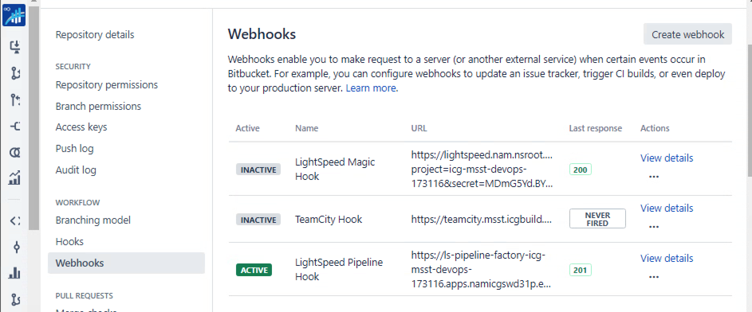
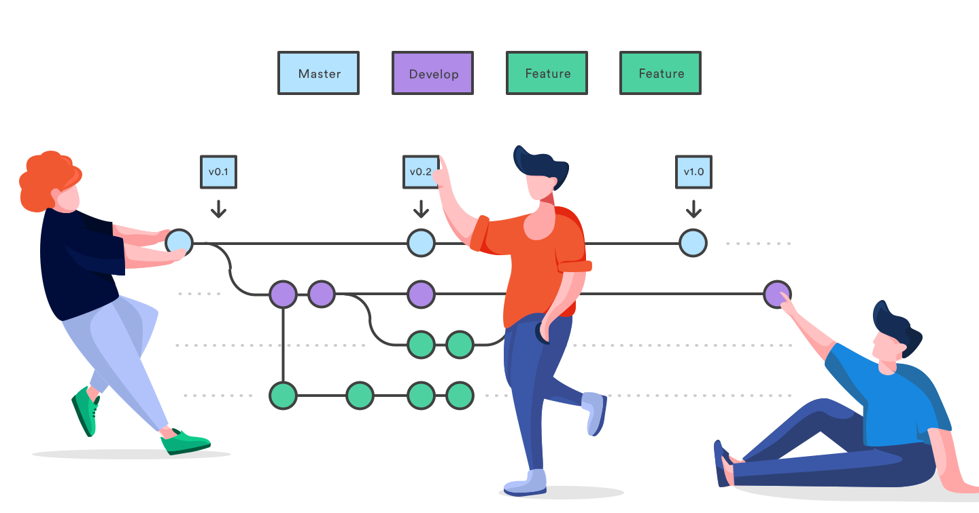
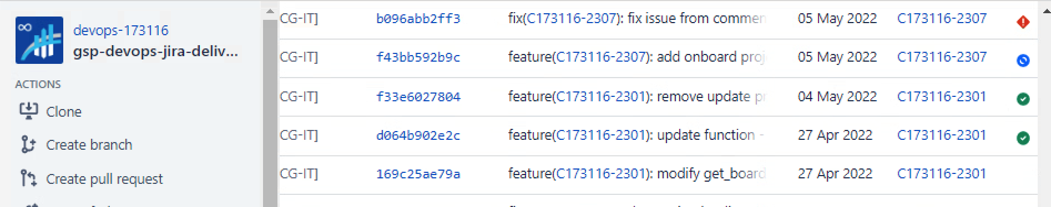
Continuous Integration
Bitbucket
Q: No build status or build status exception.
A: Search `Notify Stash` in Jenkins log. Possible cause: 1. Jenkins should be the first one route list 2. Force push results in lost commits
Q: The pipeline didn't start building after we pushed the code
A: Check the webhook and builds

Slide 2
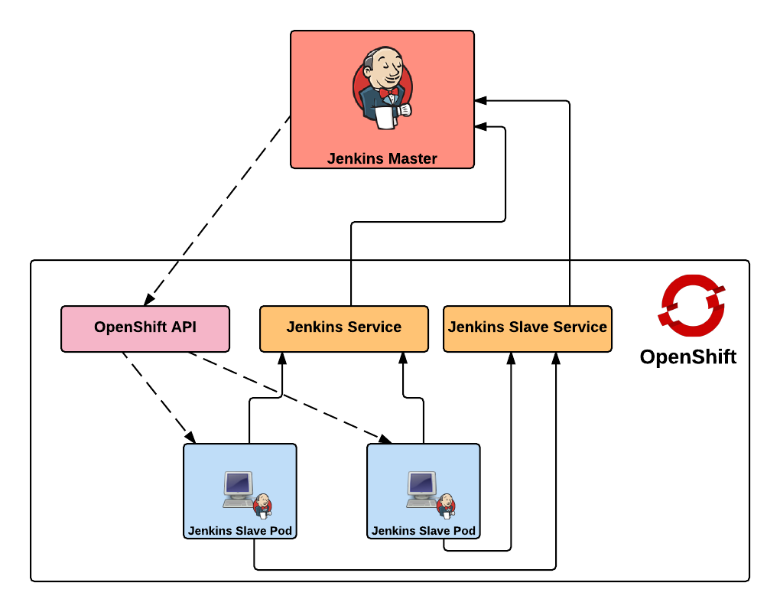
Continuous Integration
Jenkins
Q: How does it works in OpenShift?
A: Master-slave mode. Typically, we can run 5 agent pods at the same time. Each agent will be killed after 4 hours if there are no running jobs in it.
Q: What if user ask strange errors about Jenkins?
A: Please check the Jenkins logs for details. It's there.
Q: Why there is clean-up-cron job to clean up Jenkins daily?
A: It store everything in pod. It must be cleaned daily.

Slide 3
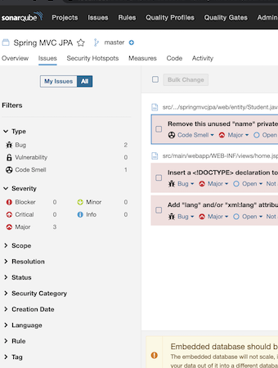
Continuous Integration
Sonarqube
Q: What should we do when Jenkins log show 404 error in Sonarqube Analysis stage?
A: Try to use `Change PipelineType` in LightSpeed UI first. If
It doesn’t work, please email to LightSpeed Support
Q: What should we do when Jenkins log show 401 error in Sonarqube Analysis stage?
A: It has to do with permission templates. But it has been cleaned up. If it happens again, please email LightSpeed Support
Q: How to decrease default sonarqube quality gate?
A: No. You can only increase your coverage rate by add more unit test or excluded some folders.

Slide 4
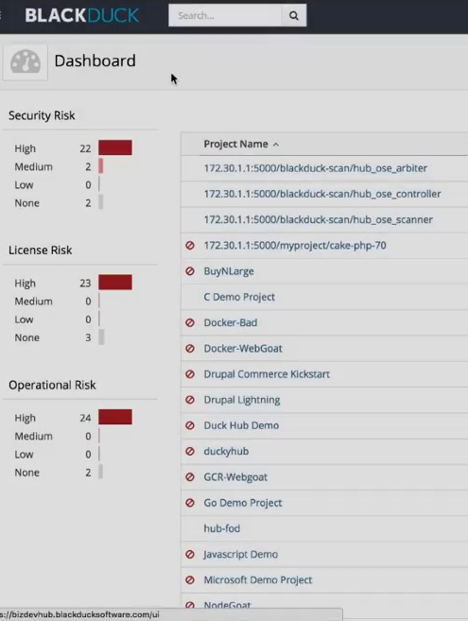
Continuous Integration
Blackduck
Q: BD Instances and Usage A:
01c —> Check Version. Yo used it for bd scan
01lw —> Manifest Scan of LightSpeed pipelines
17P —> Manifest Scan. Gradle&Maven plugin used it
01 —> Signature Scan. Only serves for production deployment and it only can be triggered by Udeploy.

Slide 5
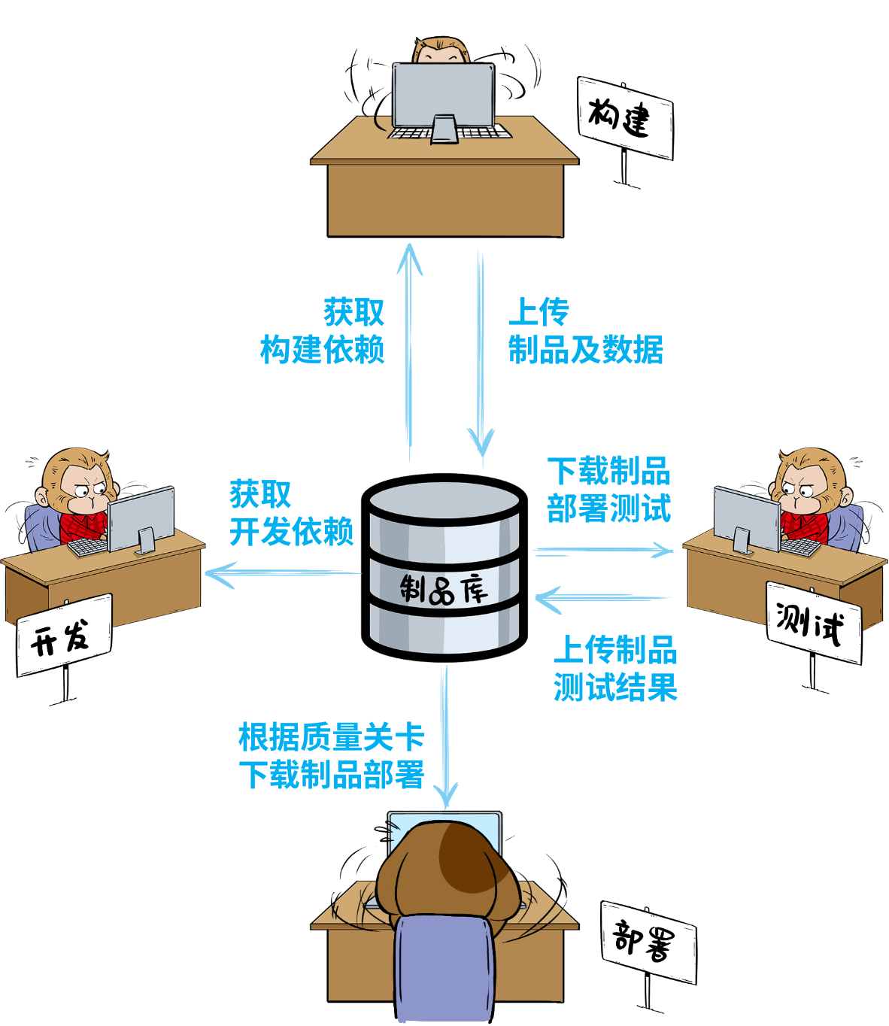
Continuous Integration
Artifactory (EAR)
Q: How we can get LS artifactory key?
A: Find .npmrc, gradle.properties, pip.ini,… in agent pod
Q: What to do if you get a 404 error when trying to download content from the EAR
A: Wait for 1 hour and try again. If it doesn’t work, please contact Artifactory Support.
Q: How do we move artifacts in artifactory from one repository to another? A: we can call ‘curl post’ to do it. But it only works for dev repository. Be careful about the virtual repository relationship.

Slide 6
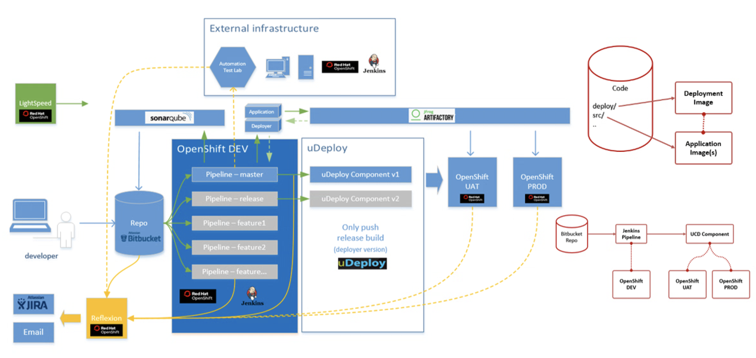
Continuous Deployment

Slide 7
Continuous Deployment
Application
Environments
Udeploy
Q: How to update OpenShift username and password?
A: Go to environment configuration. Update OPENSHIFT_USER & OPENSHIFT_PASSWORD (password need to check `secure`)
Q: What else can deploy did?
A: it can help you run shell script. For example, we can promote docker image by component process
Components
Process
Template
….

Slide 8
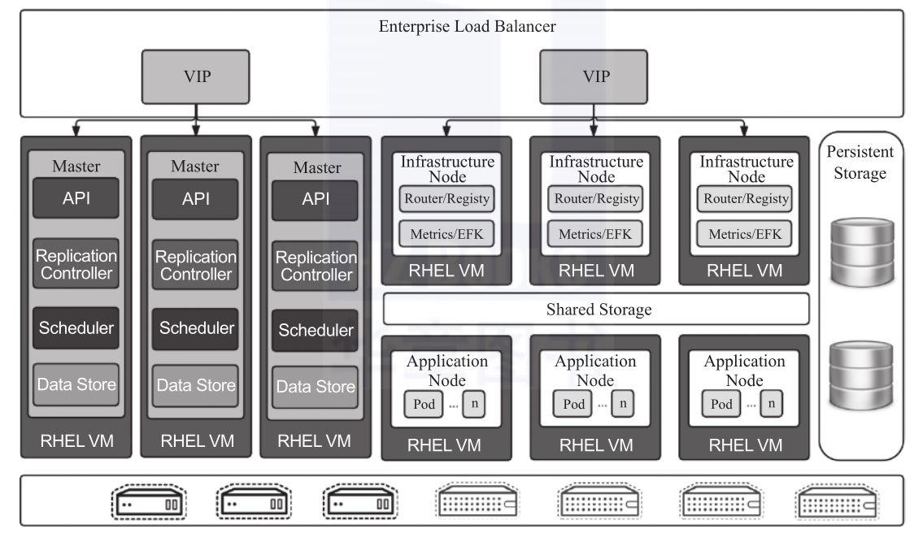
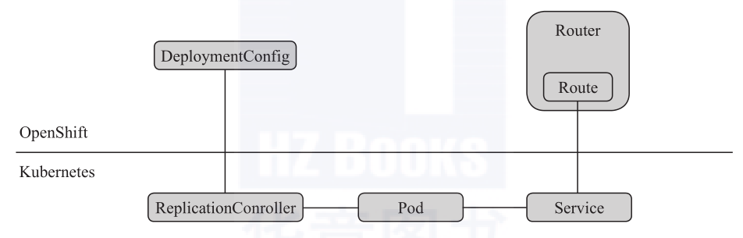
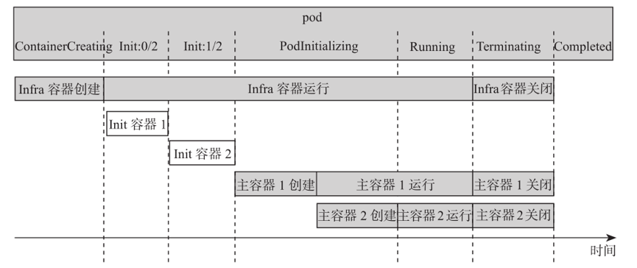
Continuous Deployment
Openshift
Q: Must know knowledge points A: DC, RC, POD, SERVICE, ROUTE
Q: What if the pod has an error state?
A: Check pod event first, log next, application code in the end.
Q: How can we debug a pod in OpenShift?
A: run `oc debug`

Slide 9
What is DevOps for me?

Slide 10





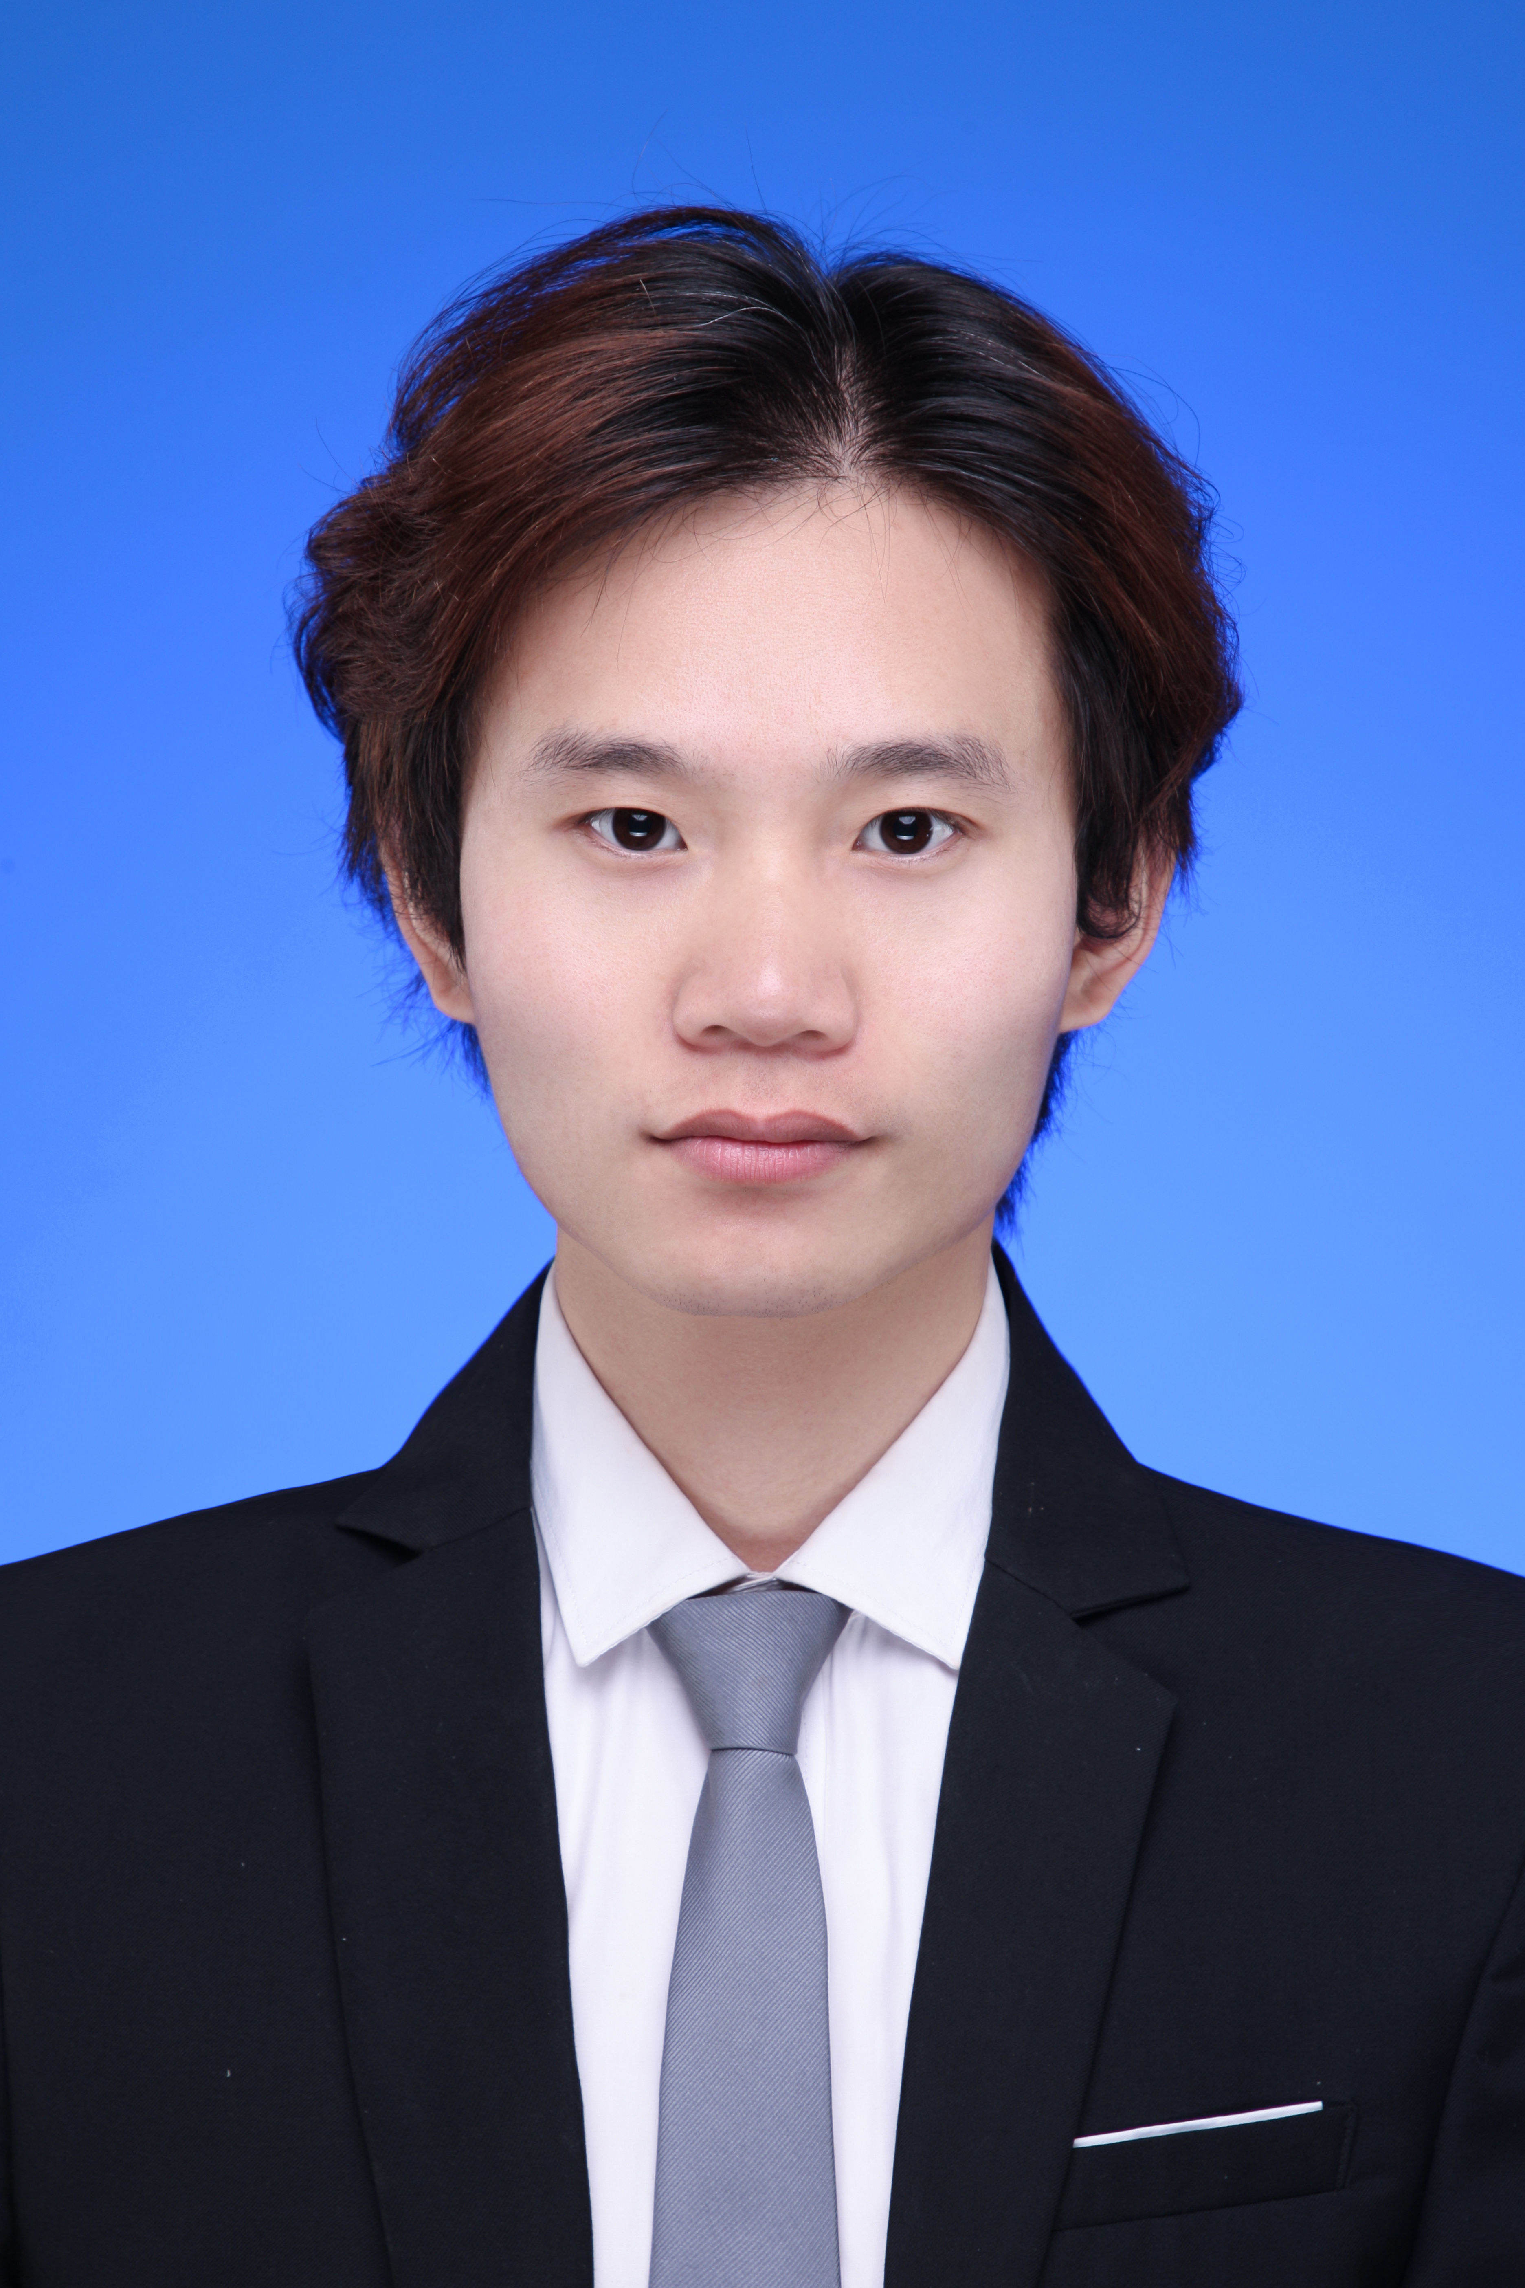






007
沉稳
WeLead
后浪
10万字
认真细致
强者
About Time
万金油
800道
活泼

Slide 11
Others
Be familiar with tools, including installation, configuration, usage, API and source code
Listening, Learning, Reading and sharing
Be professional on one front-end language and back-end language

Slide 12
Thank You!
Sincerely

